Slide 1

6th Grade Math
Unit 5, Lesson 4 Points on the Coordinate Plane – Part 2 Volume 1, pg. 221

Slide 2



Benchmark
MA.6.GR.1.1
Extend previous understanding of the coordinate plane to plot rational number ordered pairs in all four quadrants and on both axes. Identify the $x$- or $y$-axis as the line of reflection when two ordered pairs have an opposite $x$- and $y$-coordinate.
volume 1, pg. 221

Slide 3
Integrated Mathematical Thinking and Reasoning Standards
MA.K12.MTR.1.1 Actively participate in effortful learning both individually and collectively.
MA.K12.MTR.3.1 Complete tasks with mathematical fluency.
MA.K12.MTR.4.1 Engage in discussions that reflect on the mathematical thinking of self and others.
MA.K12.MTR.6.1 Assess the reasonableness of solutions.
MA.K12.MTR.7.1 Apply mathematics to real-world contexts.
volume 1, pg. 221

Slide 4

Learning Target
I can plot rational numbers using a scale of $1$.
volume 1, pg. 221

Slide 5

Warm-Up
volume 1, pg. 222

Slide 6
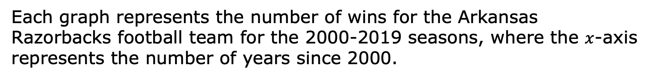
5.4.1 Warm-Up: Team Wins
Each graph represents the number of wins for the Arkansas Razorbacks football team for the 2000-2019 seasons, where the $x$-axis represents the number of years since 2000.
Graph A | Graph B
volume 1, pg. 222

Slide 7

What do you wonder about the two graphs?
What do you notice about the two graphs?
In what years did the team win at least $10$ games?
Explain how the scale of the $y$-axis impacts the graphs.
volume 1, pg. 222

Slide 8

Try It
volume 1, pg. 222

Slide 9
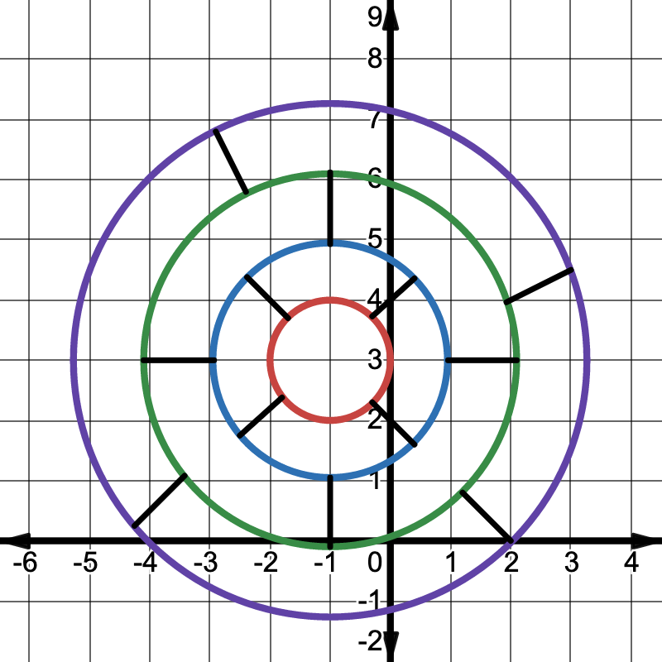
5.4.2 Try It: Game Score
A gameboard is shown on the coordinate grid, along with the number of points earned for landing in each area. Each coordinate grid axis is scaled at $1$.
volume 1, pg. 222

Slide 10
Several points are given in the table. Locate each point on the coordinate grid. Complete the table by writing the score value for landing at each point. Calculate the game score by finding the sum of all the points. Verify your answer with your teacher.
volume 1, pg. 222

Slide 11
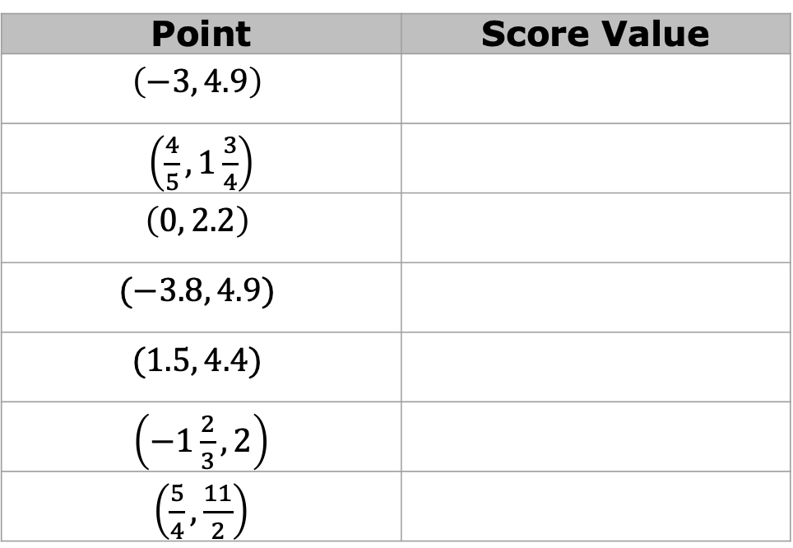
Point | Score Value
$$\left(−3, 4.9\right)$$
$\left(\frac{4}{5}, 1\frac{3}{4}\right)$
$$\left(0, 2.2\right)$$
$$(−3.8, 4.9)$$
$$(1.5, 4.4)$$
$\left(−1\frac{2}{3}, 2\right)$
$\left(\frac{5}{4}, \frac{11}{2}\right)$
Game Score: ____________
volume 1, pg. 223

Slide 12

Collaboration
volume 1, pg. 223

Slide 13
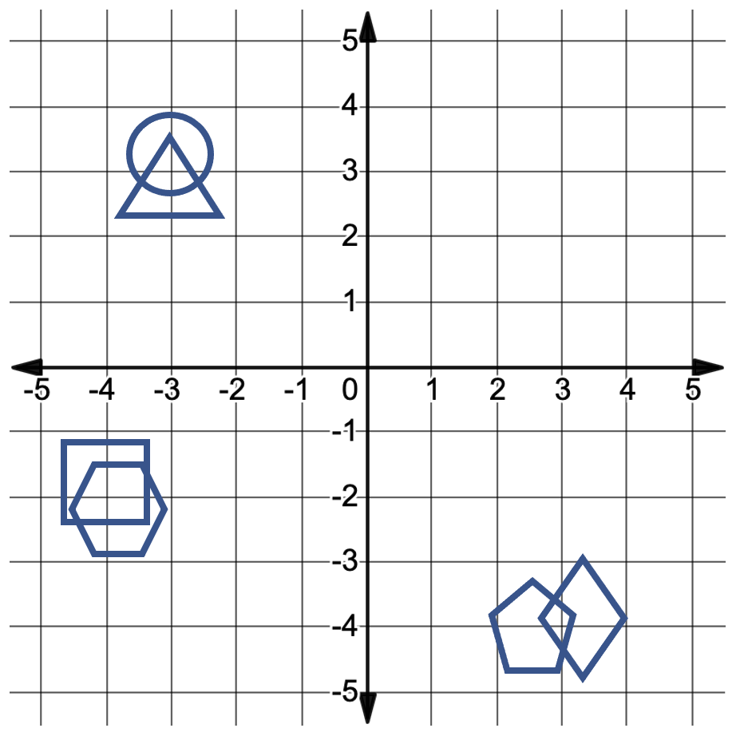
5.4.3 Collaboration: Hit or Miss
There are six shapes on the coordinate grid shown. Each partner will select one shape as their game piece. The object of the game is to guess which shape your partner selected before they guess yours. A hit means the point you guessed is inside their shape. A miss means that it is not. Keep your gameboard hidden from your partner during the game.
The shape of the region I am picking is a ______________.
volume 1, pg. 223

Slide 14
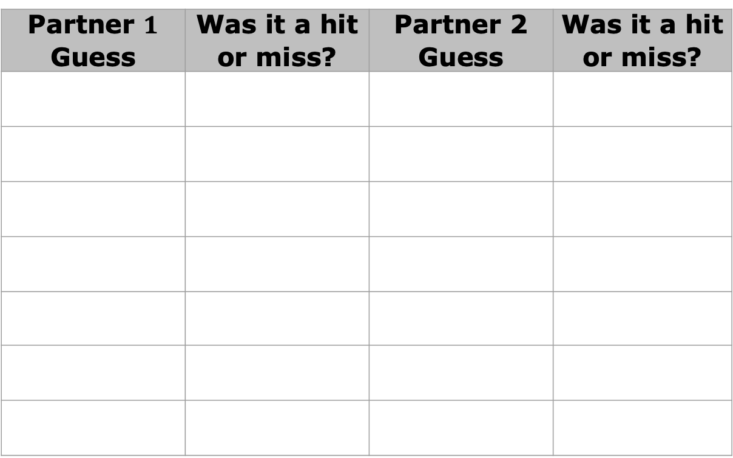
Record the coordinates of each guess in the table below. Then, plot the point on the coordinate grid gameboard.
Partner $1$ Guess | Was it a hit or miss? | Partner 2 Guess | Was it a hit or miss?
volume 1, pg. 224

Slide 15

Your Turn
volume 1, pg. 224

Slide 16
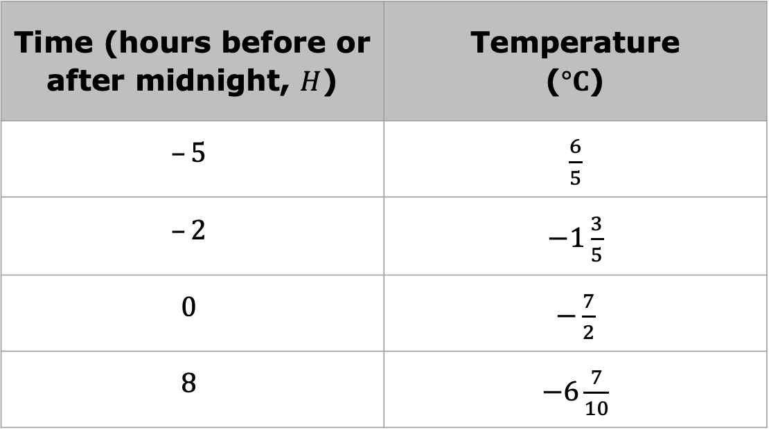
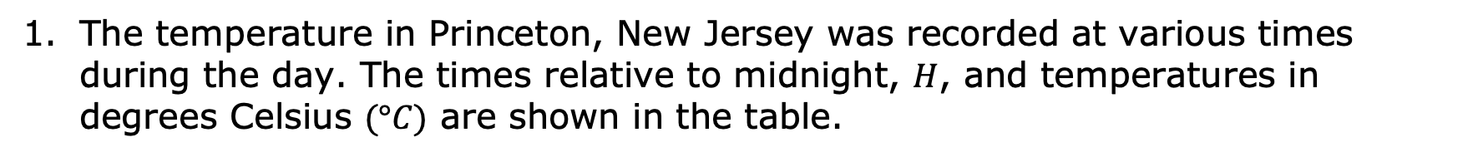
5.4.4 Your Turn!
The temperature in Princeton, New Jersey was recorded at various times during the day. The times relative to midnight, $H$, and temperatures in degrees Celsius $(°C)$ are shown in the table.
Time (hours before or after midnight, $H$) | Temperature ($°C$)
$$–5$$ | $\frac{6}{5}$
$$–2$$ | $−1\frac{3}{5}$
$$0$$ | $−\frac{7}{2}$
$$8$$ | $−6\frac{7}{10}$
volume 1, pg. 224

Slide 17
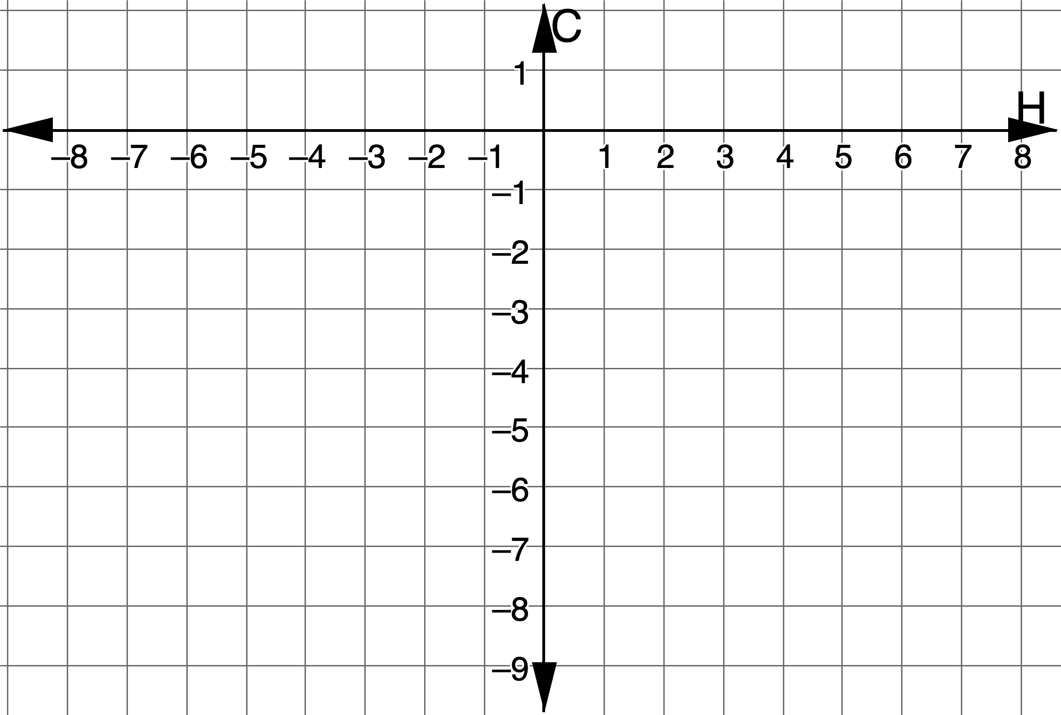
Plot the points that represent the data.
volume 1, pg. 224

Slide 18
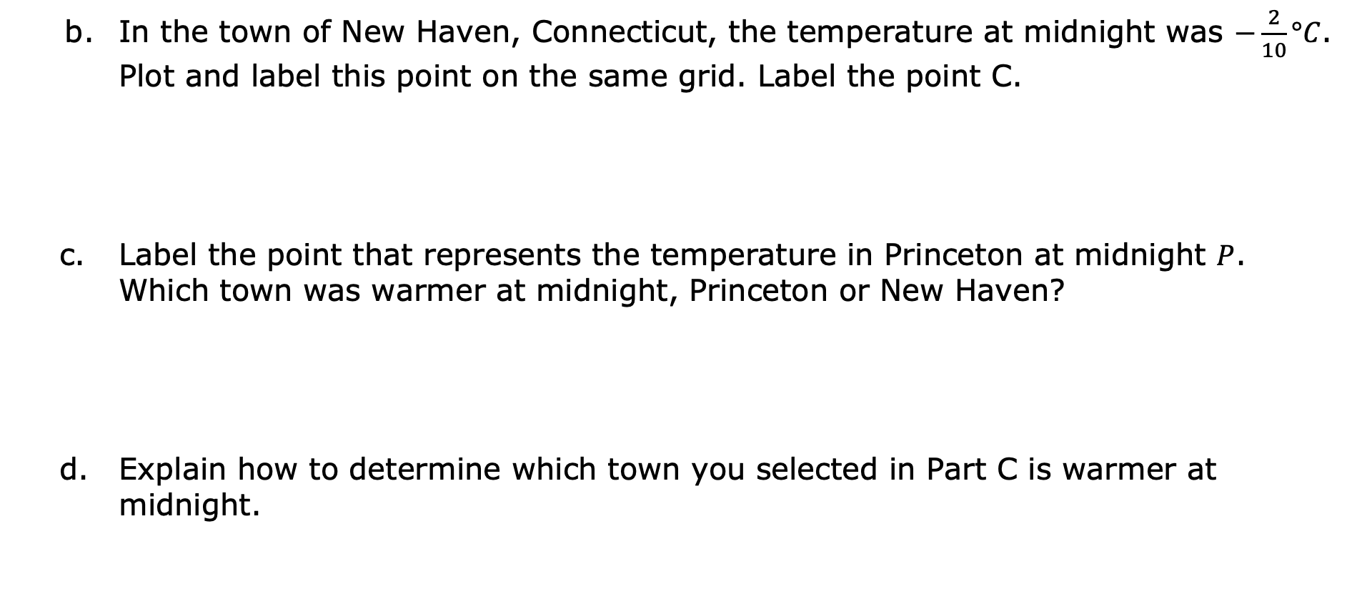
In the town of New Haven, Connecticut, the temperature at midnight was $−\frac{2}{10}°C$. Plot and label this point on the same grid. Label the point C.
Label the point that represents the temperature in Princeton at midnight $P$. Which town was warmer at midnight, Princeton or New Haven?
Explain how to determine which town you selected in Part C is warmer at midnight.
volume 1, pg. 225

Slide 19
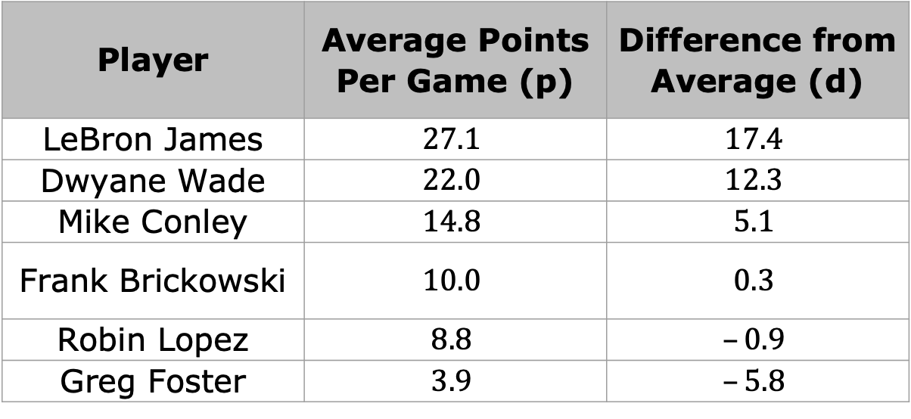
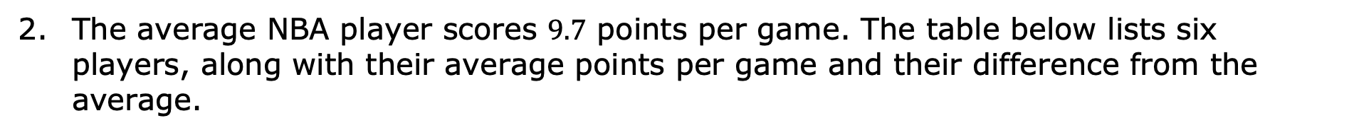
The average NBA player scores $9.7$ points per game. The table below lists six players, along with their average points per game and their difference from the average.
Player | Average Points Per Game (p) | Difference from Average (d)
LeBron James | $$27.1$$ | $$17.4$$
Dwyane Wade | $$22.0$$ | $$12.3$$
Mike Conley | $$14.8$$ | $$5.1$$
Frank Brickowski | $$10.0$$ | $$0.3$$
Robin Lopez | $$8.8$$ | $$–0.9$$
Greg Foster | $$3.9$$ | $$–5.8$$
volume 1, pg. 225

Slide 20
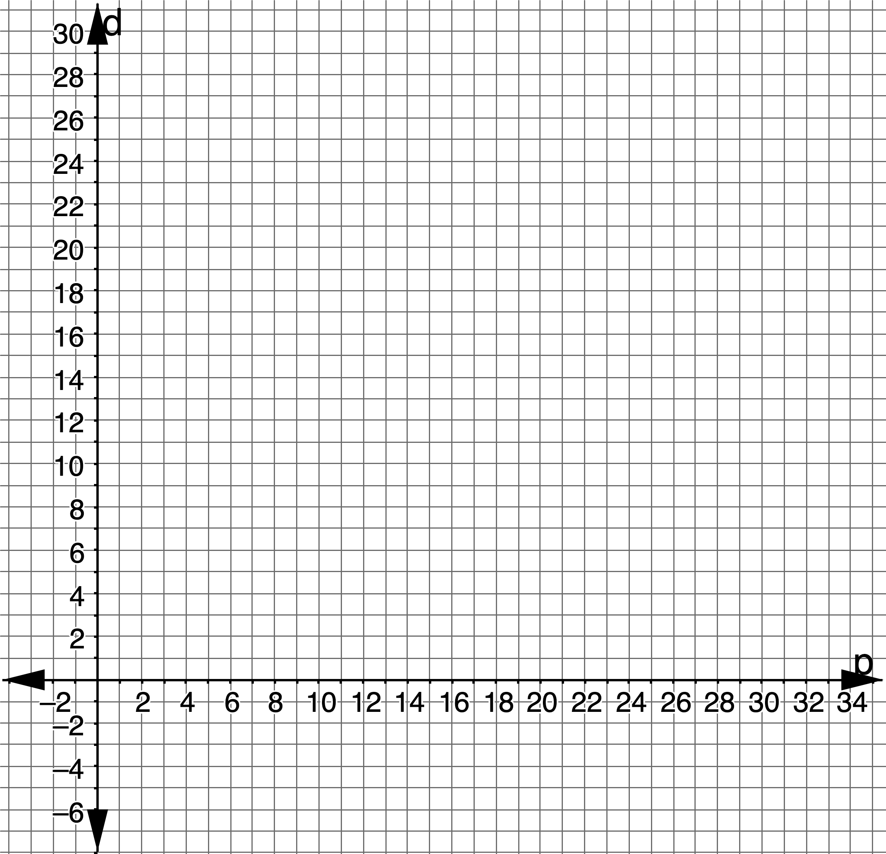
Graph the points from the table on the coordinate grid.
volume 1, pg. 225

Slide 21

Wrap-Up
volume 1, pg. 226

Slide 22
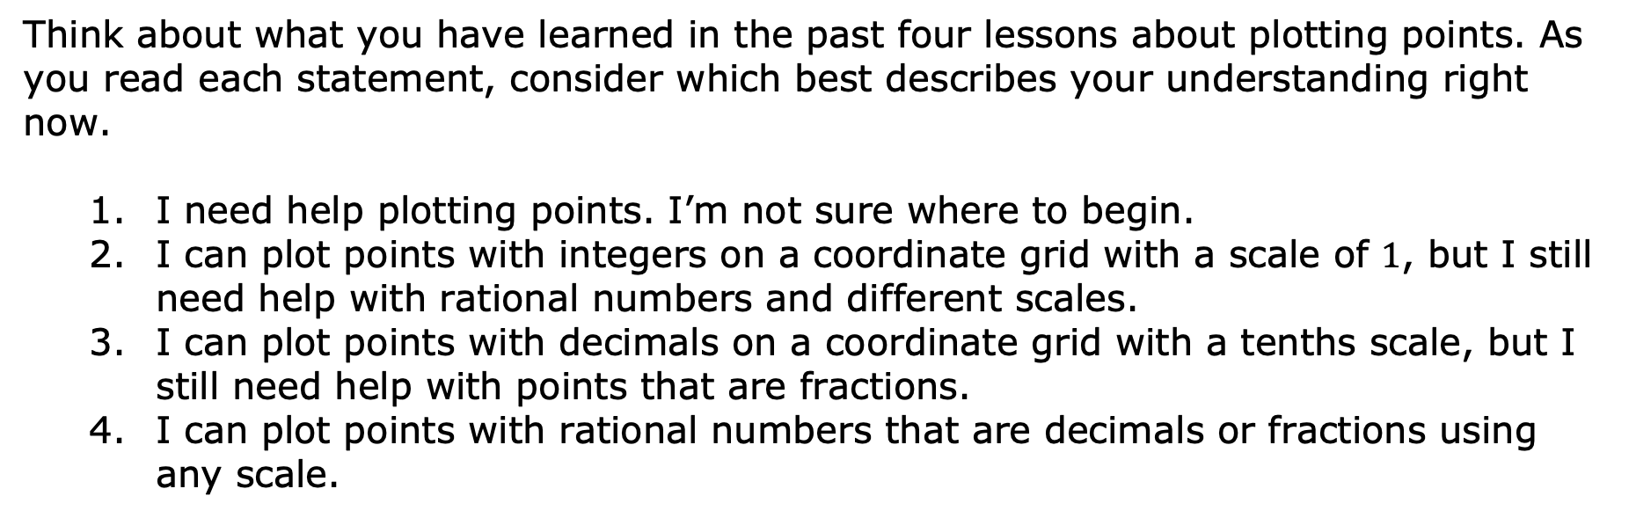
5.4.5 Wrap-Up: Reflection
Think about what you have learned in the past four lessons about plotting points. As you read each statement, consider which best describes your understanding right now.
I need help plotting points. I’m not sure where to begin.
I can plot points with integers on a coordinate grid with a scale of $1$, but I still need help with rational numbers and different scales.
I can plot points with decimals on a coordinate grid with a tenths scale, but I still need help with points that are fractions.
I can plot points with rational numbers that are decimals or fractions using any scale.
volume 1, pg. 226

Slide 23

Explain which number from the list best describes you.
Write a plan for what you can do to either move to number $4$or to help a classmate move to number $4$.
volume 1, pg. 226

